Slide 1
Syllabus of Embedded System
Unit 5: Communication Protocols (3 Hrs)
5.1 Serial Communication: UART, SPI, I2C
5.2 Wireless Communication: Bluetooth, ZigBee, Wi-Fi, LoRa, GSM/GPRS
5.3 Networking: TCP/IP Basics in Embedded Systems

Slide 2
Communication Protocols
Standardized sets of rules and digital message formats that enables information exchange between devices.
Acts as a common language that ensures data transmission is orderly, accurate, and secure.
Governs the process of sending and receiving data between devices in a two-way communication exchange.

Slide 3
Communication Protocols
Key roles of communication protocols
Device Interoperability
Data integrity
System Efficiency
Scalability

Slide 4
Serial Communication (UART, SPI, I2C)
UART, or Universal Asynchronous Receiver/ Transmitter, is a physical circuit in a microcontroller or single integrated circuit (IC) that is used to implement serial communication between devices in an embedded system.
UART, data is sent over the bus in the form of a packet. A packet consists of a start bit, data frame, a parity bit, and stop bits.
UART, supports bidirectional data transmission, including half-duplex and full-duplex operations.
UART doesn’t use a clock signal

Slide 5
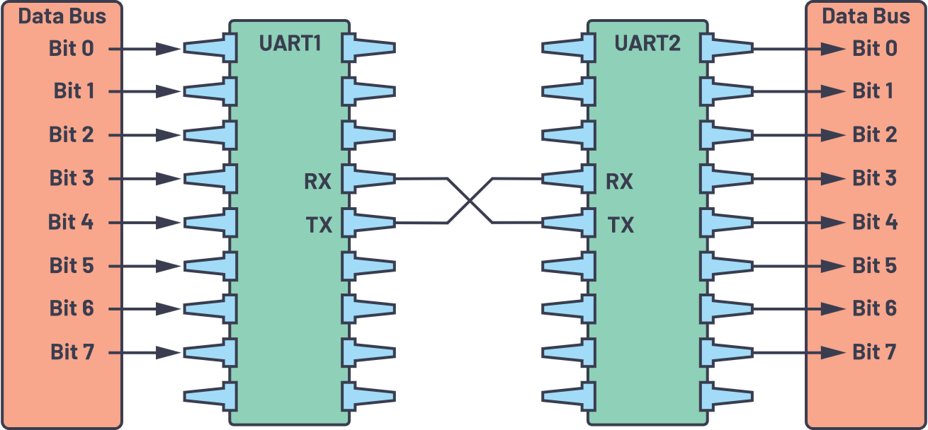
Serial Communication (UART, SPI, I2C)
UART with data bus

Slide 6
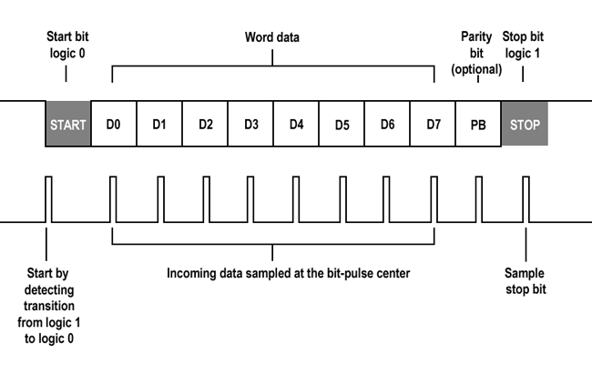
Serial Communication (UART, SPI, I2C)
UART frame format

Slide 7
Serial Communication (UART, SPI, I2C)
Advantages of UART
Simple and cost-effective
Reliable Communication
Wide Usage
Applications of UART
Debugging
Peripheral Interfaces
Embedded Systems

Slide 8
Serial Communication (UART, SPI, I2C)
Serial Peripheral Interface (SPI) is synchronous serial communication protocol.
Designed for high-speed, efficient communication.
It operates in a master-slave architecture and supports full-duplex communication.
Synchronized with a clock signal, which can operate on either the rising or falling edge of the clock cycle.

Slide 9
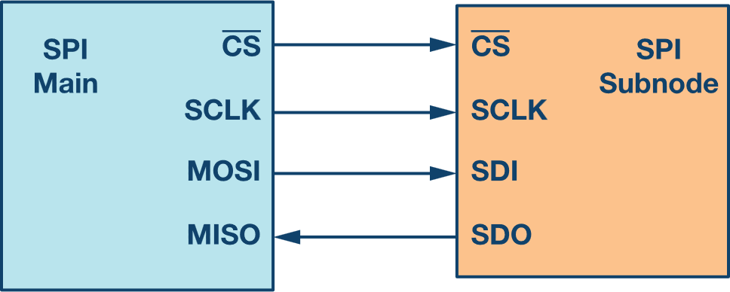
Serial Communication (UART, SPI, I2C)
SPI configuration with master and a slave
Clock (SCLK) : Clock signal is generated by the master device and is used to synchronize data transfer between the master and the slave.

Slide 10
Serial Communication (UART, SPI, I2C)
SPI configuration with master and a slave
Chip Select (CS) : The chip select signal, typically active low, is used by the master to select a specific slave device for communication.

Slide 11
Serial Communication (UART, SPI, I2C)
SPI configuration with master and a slave
Master Out Slave In (MOSI) : This data line transmits data from the master to the slave.

Slide 12
Serial Communication (UART, SPI, I2C)
SPI configuration with master and a slave
Master In, Slave Out (MISO) : This data line transmits data from the slave to the master.

Slide 13
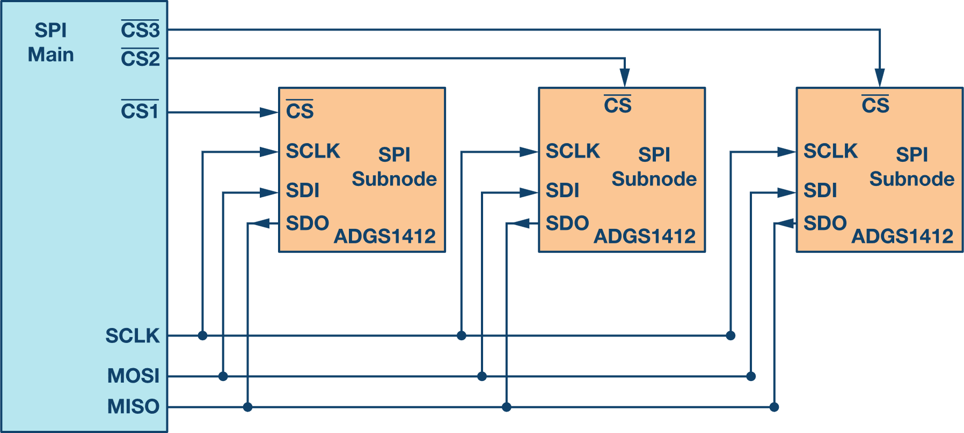
Serial Communication (UART, SPI, I2C)
Communication Process
Clock Synchronization
Data Transmission
Slave Selection
Multiple Slave Setup

Slide 14
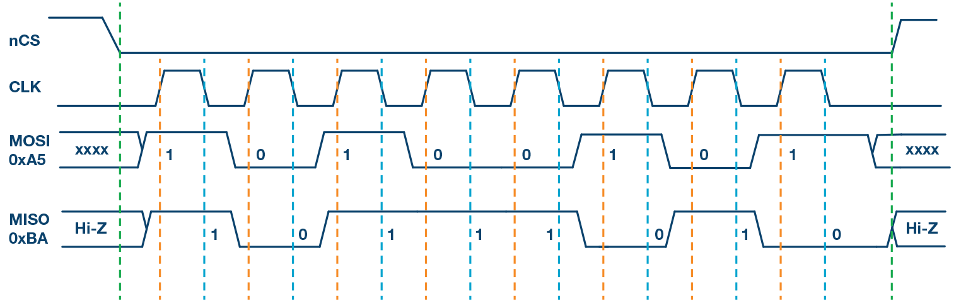
Serial Communication (UART, SPI, I2C)
SPI Mode 0, CPOL = 0, CPHA = 0: CLK idle state = low, data sampled on rising edge and shifted on falling edge.

Slide 15
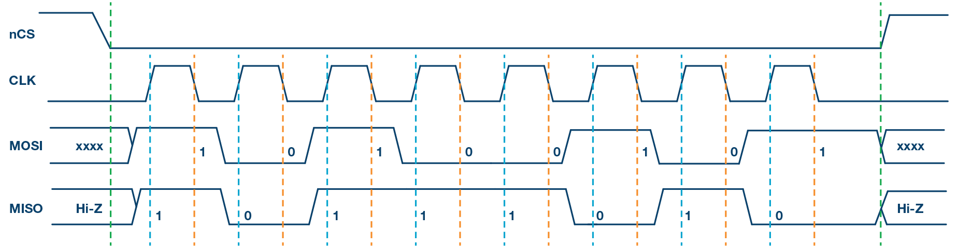
Serial Communication (UART, SPI, I2C)
SPI Mode 1, CPOL = 0, CPHA = 1: CLK idle state = low, data sampled on the falling edge and shifted on the rising edge.

Slide 16
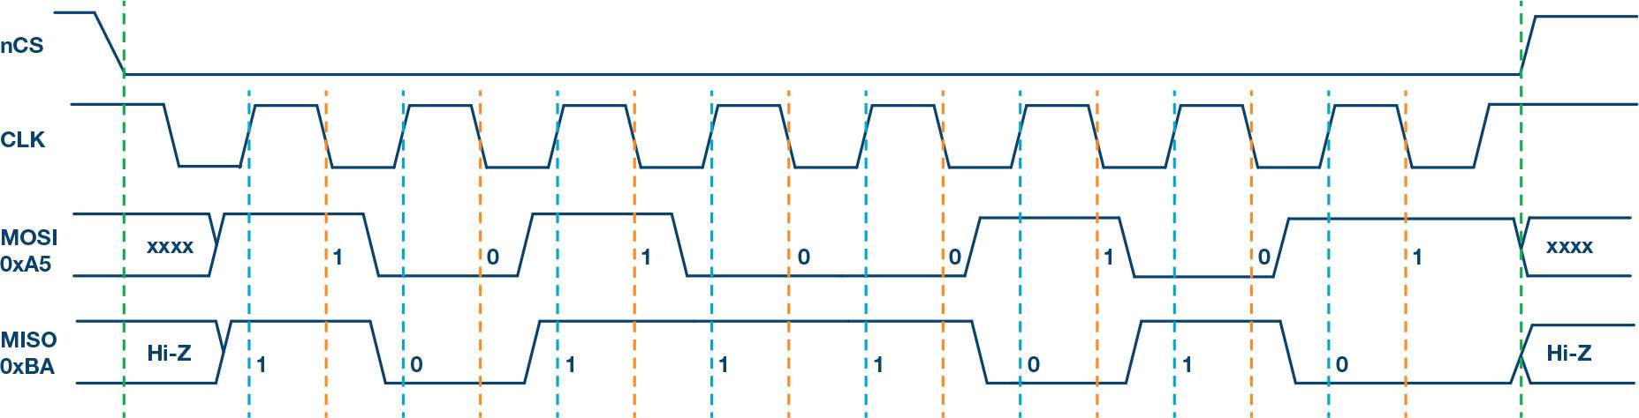
Serial Communication (UART, SPI, I2C)
SPI Mode 2, CPOL = 1, CPHA = 1: CLK idle state = high, data sampled on the falling edge and shifted on the rising edge.

Slide 17
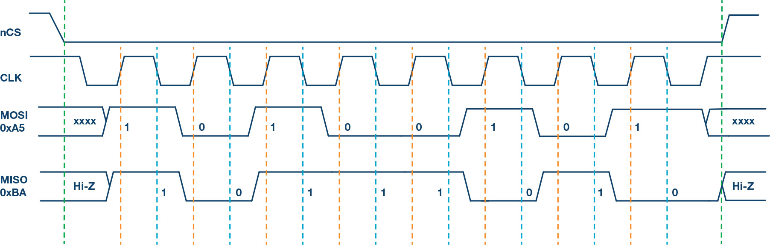
Serial Communication (UART, SPI, I2C)
SPI Mode 3, CPOL = 1, CPHA = 0: CLK idle state = high, data sampled on the rising edge and shifted on the falling edge.

Slide 18
Serial Communication (UART, SPI, I2C)
Advantages of SPI
High-speed communication
Full-duplex Operation
Simple Hardware Requirement
Support for multiple Slaves
Applications of SPI
Memory Devices
Sensors
Display Modules
Communication Peripherals

Slide 19
Serial Communication (UART, SPI, I2C)
Inter-Integrated Circuit Protocol, is a widely used two wire interface in embedded systems.
I2C allows multiple masters and slaves to share a single bus.
Its synchronous, half-duplex design minimizes wiring complexity.
There are only wires: Serial Data (SDA) and Serial Clock (SCL). Thus, also known as Two Wire Interface.

Slide 20
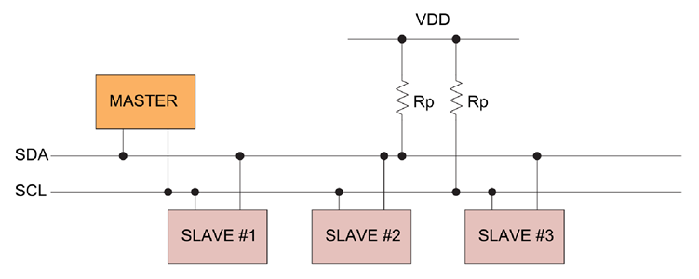
Serial Communication (UART, SPI, I2C)
Generalized I2C connection diagram

Slide 21
Serial Communication (UART, SPI, I2C)
Communication Process
Start Condition
Addressing
Data Transfer
Stop Condition

Slide 22
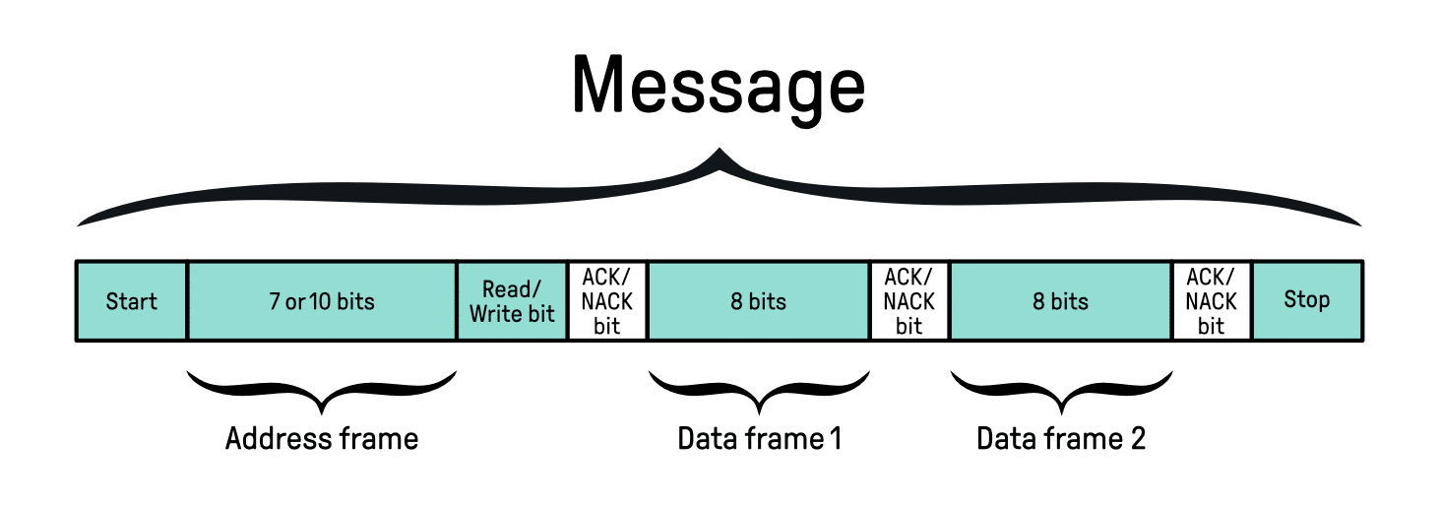
Serial Communication (UART, SPI, I2C)
Frame format

Slide 23
Serial Communication (UART, SPI, I2C)
Advantages of I2C
Simplified Wiring
Supports Multiple Devices
Synchronous Data Transfer
Built-in Acknowledgement
Applications of I2C
Sensor Integration
Display Communication
Memory Modules
Embedded Systems

Slide 24
Wireless Communication: Bluetooth, ZigBee, Wi-Fi, LoRa, GSM/GPRS
Best for: Direct-to-smartphone connectivity and simple cable replacement.
Design Advantage: Native support on almost all modern mobile devices. You don’t need a gateway to talk to a phone.
Latency: Optimized for short bursts; has very fast "wake-to-connect" times (~3ms).
Embedded Tip: Use BLE 5.0+ features like Coded PHY if you need extra range at the cost of data rate, or 2M PHY for higher throughput.

Slide 25
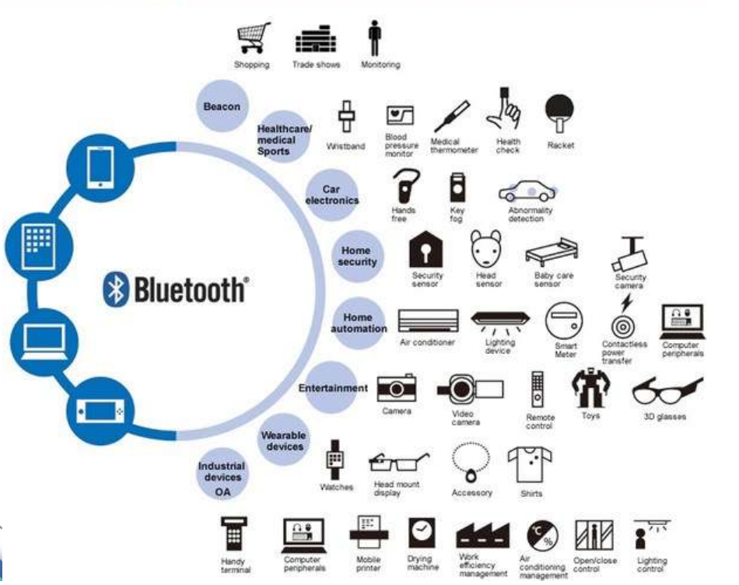
Wireless Communication: Bluetooth, ZigBee, Wi-Fi, LoRa, GSM/GPRS

Slide 26
Wireless Communication: Bluetooth, ZigBee, Wi-Fi, LoRa, GSM/GPRS
Best for: Large-scale sensor networks (e.g., 50+ light switches or temperature sensors).
Design Advantage: Superior Self-Healing Mesh. If one node fails, data automatically reroutes. It is much more robust for "whole-house" or industrial floor coverage than BLE.
Integration Challenge: Requires a Gateway (Hub) to connect to the Internet or a smartphone.
Embedded Tip: Ensure you use a "Full Function Device" (FFD) for mains-powered nodes to act as routers, and "Reduced Function Devices" (RFD) for battery-powered end-nodes.

Slide 27
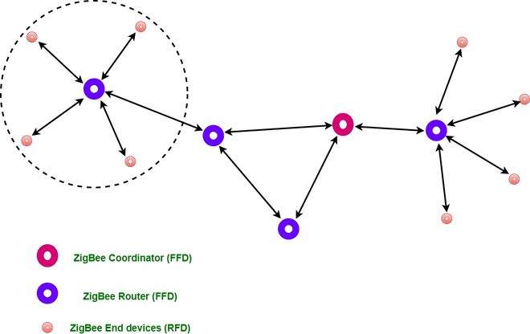
Wireless Communication: Bluetooth, ZigBee, Wi-Fi, LoRa, GSM/GPRS

Slide 28
Wireless Communication: Bluetooth, ZigBee, Wi-Fi, LoRa, GSM/GPRS
Best for: High-bandwidth applications like security cameras or devices that must connect directly to the Cloud without a hub.
Power Challenge: The "Keeping Alive" overhead of TCP/IP is taxing. It is difficult to run a Wi-Fi device on a coin-cell battery for long periods.
Security: Requires WPA2/WPA3 implementation, which is more resource-heavy for the MCU than Zigbee’s AES-128.
Embedded Tip: If battery life is critical but Wi-Fi is required, use Wi-Fi 6 (802.11ax) modules that support Target Wake Time (TWT), which allows the device to sleep for long periods.

Slide 29
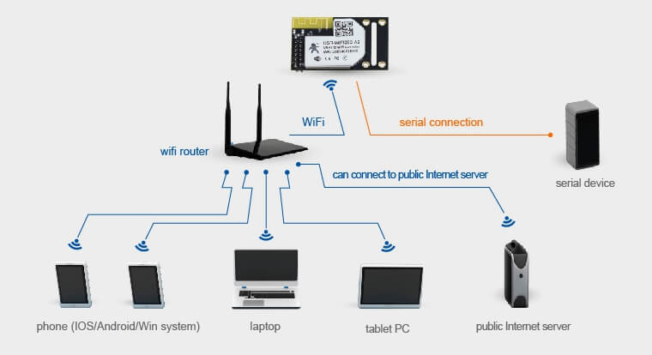
Wireless Communication: Bluetooth, ZigBee, Wi-Fi, LoRa, GSM/GPRS

Slide 30
Wireless Communication: Bluetooth, ZigBee, Wi-Fi, LoRa, GSM/GPRS
Feature | Bluetooth Low Energy (BLE) | Zigbee | Wi-Fi (802.11 b/g/n/ax)
Standard | IEEE 802.15.1 | IEEE 802.15.4 | IEEE 802.11
Data Rate | 1 Mbps to 2 Mbps | 250 Kbps | 11 Mbps to 10 Gbps+
Power Consumption | Ultra-Low (Months/Years) | Very Low (Months/Years) | High (Days/Weeks)
Network Topology | Star, Point-to-point, Mesh | Mesh, Star, Tree | Star (Access Point)
Max Nodes | ~20–30 (Star); 32k (Mesh) | 65,000+ | ~250 per Access Point
Indoor Range | ~10–30 meters | ~10–100 meters | ~50–100 meters
Primary Use | Wearables, Peripherals | Smart Home, Industrial | Video, Web, Cloud

Slide 31
Wireless Communication: Bluetooth, ZigBee, Wi-Fi, LoRa, GSM/GPRS
Best for: Battery-powered sensors in remote areas (e.g., soil moisture, tank levels).
Design Advantage: Extremely high receiver sensitivity allows signals to travel through buildings or even underground. You can build your own Private Network with a single gateway and zero monthly fees.
Duty Cycle Limits: In many regions (like the EU), you are legally restricted to a 1% duty cycle (e.g., transmitting for only 36 seconds per hour).
Embedded Tip: Choose your Spreading Factor (SF) carefully. A higher SF increases range but also increases "Time-on-Air," which drains the battery faster and risks packet collisions.

Slide 32
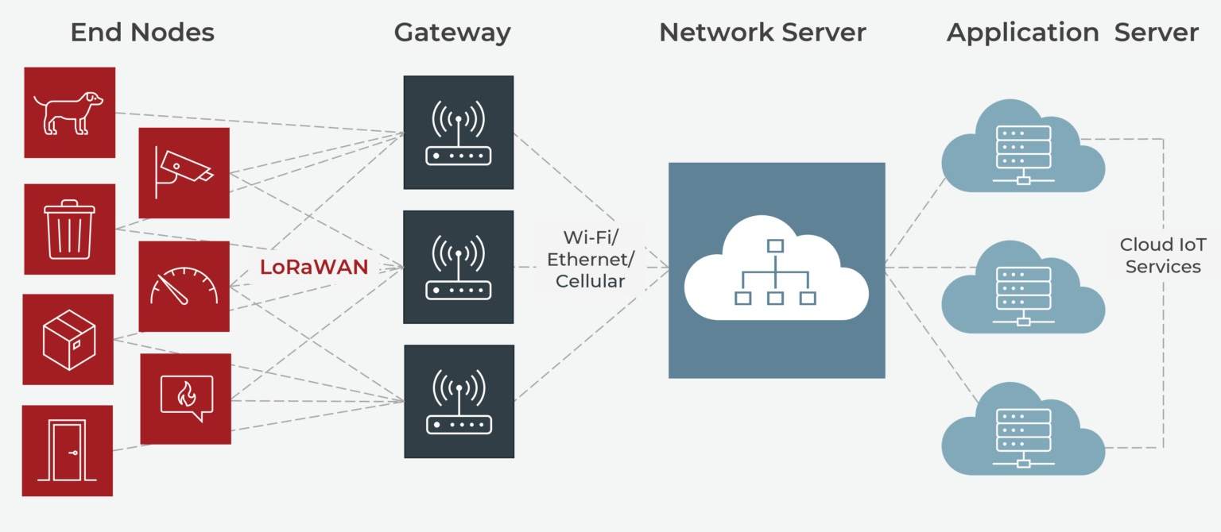
Wireless Communication: Bluetooth, ZigBee, Wi-Fi, LoRa, GSM/GPRS

Slide 33
Wireless Communication: Bluetooth, ZigBee, Wi-Fi, LoRa, GSM/GPRS
Best for: Mobile applications that move across cities or countries where you cannot install your own gateways.
Design Advantage: "Always-on" connectivity. Unlike LoRa, which is mostly "fire and forget" for small packets, GPRS allows for a persistent TCP/IP connection.
Power Challenge: GSM modules (like the SIM800 series) can pull 2A current spikes during transmission. You must design your power supply with large decoupling capacitors (e.g., 1000µF+) to prevent MCU burnouts.
Embedded Tip: For modern designs, look into LTE-M or NB-IoT modules. They offer cellular coverage with significantly lower power consumption than traditional 2G/3G.

Slide 34
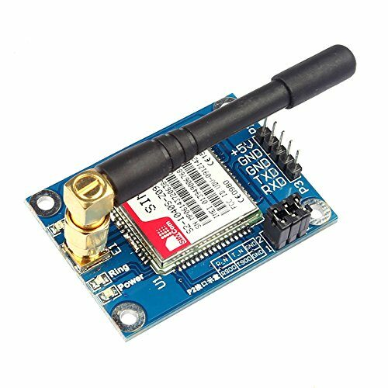
Wireless Communication: Bluetooth, ZigBee, Wi-Fi, LoRa, GSM/GPRS
GSM Module

Slide 35
Wireless Communication: Bluetooth, ZigBee, Wi-Fi, LoRa, GSM/GPRS
Feature | LoRa / LoRaWAN | GSM (2G) / GPRS
Network Type | LPWAN (Unlicensed) | Cellular (Licensed)
Range | 2–5 km (Urban), 15 km+ (Rural) | Virtually unlimited (Cell tower based)
Data Rate | 0.3 Kbps to 50 Kbps | ~30 Kbps to 115 Kbps
Power Consumption | Ultra-Low (Years on battery) | High (Needs large battery/mains)
Subscription Cost | None (Private) or Low (Public) | Monthly SIM data plan required
Hardware Cost | Medium ($3–$10 per module) | Higher ($10–$25 per module)
Primary Use | Remote sensors, Smart agriculture | Asset tracking, Remote monitoring

Slide 36
Networking: TCP/IP Basics in Embedded Systems
Key benefits includes:
High Level Abstraction: Digital circuits can be modeled in various levels.
Simulation before Implementation: Circuits can be verified through simulation.
Hardware Portability: Can be synthesized for different target devices.
Concurrent Design: Supports concurrent operations, aligning with nature of digital circuits.

